Slide 1
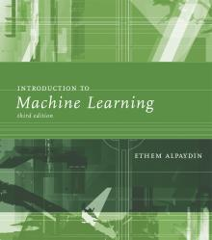
INTRODUCTION TO Machine Learning 3rd Edition
Lecture Slides for
ETHEM ALPAYDIN
© The MIT Press, 2014
alpaydin@boun.edu.tr
http://www.cmpe.boun.edu.tr/~ethem/i2ml3e

Slide 2
CHAPTER 3: Bayesian Decision Theory

Slide 3
Probability and Inference
Result of tossing a coin is ∈ {Heads,Tails}
Random var X ∈{1,0}
Bernoulli: P {X=1} = p_{o}^{X} (1 ‒ p_{o})^{(1 ‒ X)}
Sample: X = {x^{t} }^{N}_{t =1}
Estimation: p_{o} = # {Heads}/#{Tosses} = ∑_{t} x^{t} / N
Prediction of next toss:
Heads if p_{o} > ½, Tails otherwise

Slide 4
Classification
Credit scoring: Inputs are income and savings.
Output is low-risk vs high-risk
Input: x = [x₁,x₂]^{T} ,Output: C Î {0,1}
Prediction:

Slide 5
Bayes’ Rule
prior
likelihood
posterior
evidence

Slide 6
Bayes’ Rule: K>2 Classes

Slide 7
Losses and Risks
Actions: α_{i}
Loss of α_{i} when the state is C_{k} : λ_{ik}
Expected risk (Duda and Hart, 1973)

Slide 8
Losses and Risks: 0/1 Loss
For minimum risk, choose the most probable class

Slide 9
Losses and Risks: Reject

Slide 10
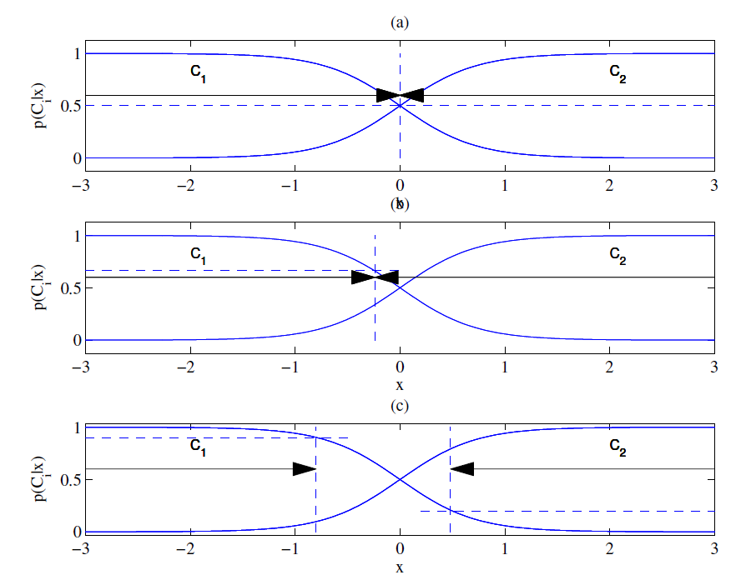
Different Losses and Reject
Equal losses
Unequal losses
With reject

Slide 11
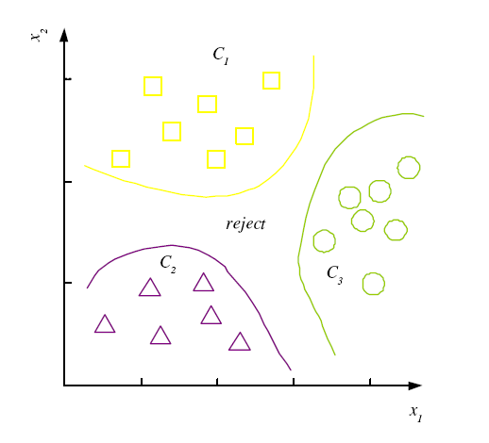
Discriminant Functions
K decision regions R₁,...,R_{K}

Slide 12
K=2 Classes
Dichotomizer (K=2) vs Polychotomizer (K>2)
g(x) = g₁(x) – g₂(x)
Log odds:

Slide 13
Utility Theory
Prob of state k given exidence x: P (S_{k}|x)
Utility of α_{i} when state is k: U_{ik}
Expected utility:

Slide 14
Association Rules
Association rule: X → Y
People who buy/click/visit/enjoy X are also likely to buy/click/visit/enjoy Y.
A rule implies association, not necessarily causation.

Slide 15
Association measures
Support (X → Y):
Confidence (X → Y):
Lift (X → Y):

Slide 16
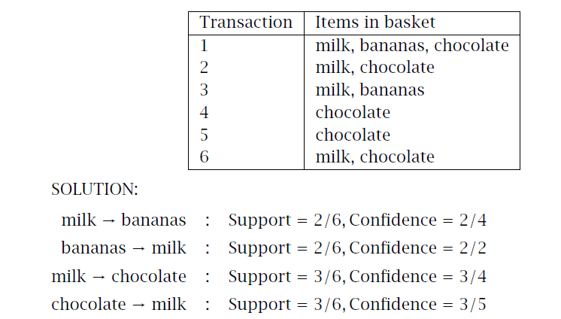
Example

Slide 17
Apriori algorithm (Agrawal et al., 1996)
For (X,Y,Z), a 3-item set, to be frequent (have enough support), (X,Y), (X,Z), and (Y,Z) should be frequent.
If (X,Y) is not frequent, none of its supersets can be frequent.
Once we find the frequent k-item sets, we convert them to rules: X, Y → Z, ...
and X → Y, Z, ...

